Slide 1

GitLab CI/CD Integration with ArgoCD
GitOps Workflow
Automating Kubernetes Deployments

Slide 2
Agenda
1
2
Introduction to GitOps
Why integrate GitLab with ArgoCD?
Understanding the fundamentals
Benefits and use cases
3
4
ArgoCD Architecture Overview
Integration Approaches
Core components and structure
Pull-based vs Push-based models
5
6
GitLab CI/CD Pipeline Setup
ArgoCD Application Setup
Configuration and implementation
YAML configuration examples
7
8
Secure Authentication
End-to-End Workflow Demo
GitLab to ArgoCD security
Complete process walkthrough
9
10
Best Practices
Summary
Security and optimization tips
Key takeaways and next steps

Slide 3


What is GitOps?
Git as Single Source of Truth
Declarative Configuration
All infrastructure and application configurations stored in Git repositories
YAML and Helm charts define desired state of systems
Continuous Reconciliation
Automated sync between Git state and cluster reality
Popular GitOps Tools: ArgoCD, FluxCD, Jenkins X
Commit Code
Detect Change
Sync & Deploy

Slide 4






Why GitLab + ArgoCD?
GitLab Handles CI
ArgoCD Handles CD
Build applications
Sync manifests
Run tests
Deploy to clusters
Push container images
Monitor applications
Key Benefits
Separation of Concerns
Secure & Auditable
Clear division between CI and CD responsibilities
Complete deployment audit trail through Git history
Zero-Downtime Deployments
Easy Rollbacks
GitOps ensures smooth, automated rollouts
Instant rollback capability via Git commit history

Slide 5
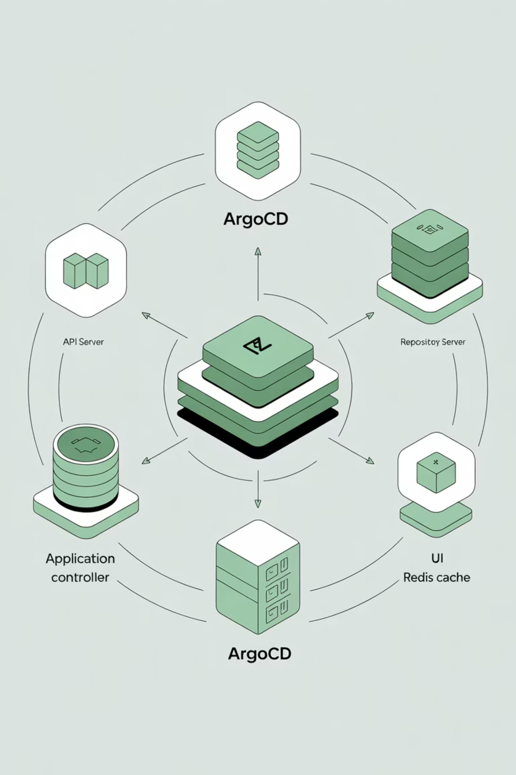




ArgoCD Architecture
ArgoCD API Server
Serves the web UI, CLI, and API endpoints. Handles authentication and authorization for all ArgoCD operations.
Repository Server
Connects to Git repositories, retrieves manifests, and renders Helm charts or Kustomize configurations.
Application Controller
Core sync engine that continuously monitors Git repos and reconciles desired state with cluster reality.
Redis Cache
Provides caching and temporary storage for application state and repository data to improve performance.

Slide 6
Integration Approaches
Pull-based (Auto-Sync)
Push-based (Triggered)
ArgoCD continuously watches GitLab repository and automatically syncs any detected changes to the cluster.
GitLab CI/CD pipeline explicitly calls ArgoCD API to trigger synchronization after successful builds and tests.
Characteristics: Simple setup, pure GitOps approach, minimal configuration required.
Characteristics: Controlled rollout, integration with CI/CD gates, explicit deployment triggers.
Comparison Matrix
Aspect
Pull-based
Push-based
Setup Complexity
Simple
Moderate
GitOps Purity
High
Medium
Deployment Control
Automatic
Manual/Gated
CI/CD Integration
Loose
Tight
Rollback Speed
Fast
Depends on pipeline

Slide 7
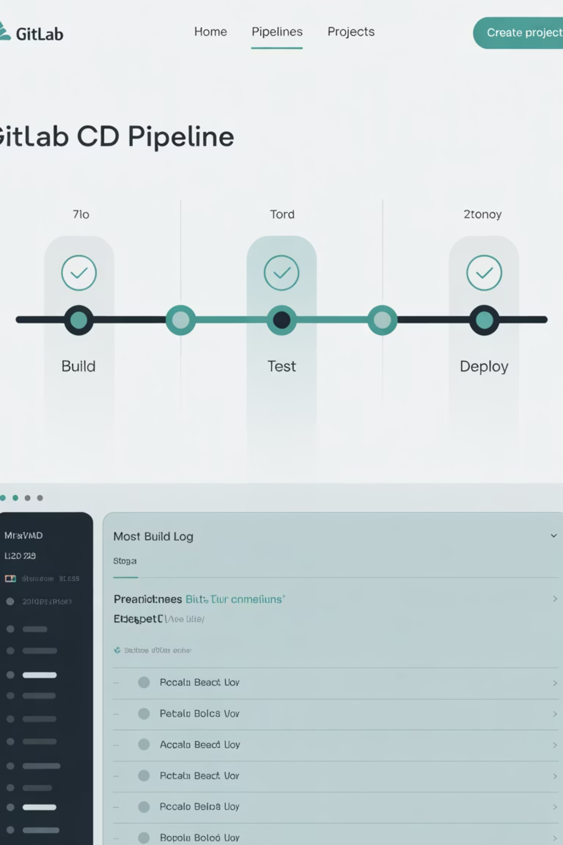
GitLab CI/CD Pipeline Setup
1
Build Stage
Compile code, build Docker images, and push to container registry
2
Test Stage
Run unit tests, integration tests, and security scans
3
Deploy Stage
Update Kubernetes manifests and trigger ArgoCD synchronization
GitLab CI Configuration Example
stages: - build - deploydeploy: stage: deploy script: - curl -k -H "Authorization: Bearer $ARGOCD_AUTH_TOKEN" \ -X POST https://argocd-server/api/v1/applications/my-app/sync only: - main

Slide 8
ArgoCD Application Setup
ArgoCD applications are defined using YAML manifests that specify the source repository, target cluster, and synchronization policies.
apiVersion: argoproj.io/v1alpha1kind: Applicationmetadata: name: my-app namespace: argocdspec: source: repoURL: https://gitlab.com/my-repo path: k8s targetRevision: main destination: server: https://kubernetes.default.svc namespace: demo syncPolicy: automated: prune: true selfHeal: true
1
2
3
Source Configuration
Destination Settings
Sync Policy
Defines the Git repository URL, path to Kubernetes manifests, and target branch or tag for deployment.
Specifies the target Kubernetes cluster and namespace where the application will be deployed.
Controls automated synchronization behavior, including pruning unused resources and self-healing capabilities.

Slide 9


Authentication & Security
Setting Up Secure Integration
Create ArgoCD Service Account
Generate a dedicated CI bot account for GitLab integration with limited permissions.
Generate API Token
argocd account generate-token --account ci-bot
Store in GitLab Variables
Add token to GitLab → Settings → CI/CD → Variables as ARGOCD_AUTH_TOKEN
Security Best Practices
Implement least privilege RBAC policies
Never store secrets directly in Git repositories
Use encrypted CI/CD variables for sensitive data
Regularly rotate API tokens and access keys
Enable TLS encryption for all ArgoCD communications

Slide 10





End-to-End Workflow
Developer Commits
Developer pushes code changes to GitLab repository, triggering the CI/CD pipeline.
GitLab CI Builds
GitLab CI builds container image, runs tests, and updates Kubernetes manifests.
Trigger ArgoCD
GitLab triggers ArgoCD sync (push model) or ArgoCD auto-detects changes (pull model).
Deploy to Cluster
ArgoCD reconciles desired state and deploys application to Kubernetes cluster.
Monitor Deployment
Track deployment status and application health via ArgoCD UI and CLI tools.
This workflow ensures complete automation from code commit to production deployment, with full audit trails and rollback capabilities through Git history.

Slide 11




Best Practices
Separate CI and CD
Use Template Tools
Secure ArgoCD
Keep GitLab focused on continuous integration (build, test) and ArgoCD focused on continuous deployment (sync, deploy).
Leverage Helm charts or Kustomize for reusable, parameterized Kubernetes manifests across environments.
Implement RBAC policies, enable TLS encryption, and use service accounts with minimal required permissions.
Enable Drift Correction
External Secret Management
Configure prune: true and selfHeal: true in sync policies to automatically correct configuration drift and maintain desired state.
Store sensitive data in HashiCorp Vault, Sealed Secrets, or cloud-native secret managers rather than Git repositories.

Slide 12
Demo Steps
Follow these steps to implement a complete GitLab CI/CD integration with ArgoCD in your environment.
01
02
03
Install ArgoCD
Setup GitLab Project
Configure GitLab Runner
Deploy ArgoCD to your Kubernetes cluster using the official installation manifests.
Create a GitLab project with .gitlab-ci.yml file containing build, test, and deployment stages.
Register and configure a GitLab Runner to execute your CI/CD pipelines with appropriate permissions.
kubectl create namespace argocdkubectl apply -n argocd -f https://raw.githubusercontent.com/argoproj/argo-cd/stable/manifests/install.yaml
04
05
Test End-to-End Flow
Verify Rollback
Push code changes to trigger the pipeline and observe ArgoCD automatically deploy your application.
Test rollback functionality by reverting a Git commit and confirming ArgoCD syncs the previous state.

Slide 13


Summary
Clear Separation
GitLab excels at continuous integration - building, testing, and packaging applications. ArgoCD specializes in continuous deployment - syncing and deploying to clusters.
GitOps Benefits
This integration provides complete auditability through Git history, automated rollback capabilities, and declarative infrastructure management.
Flexible Integration Models
Security-First Approach
Production-Ready
Both pull-based (ArgoCD auto-sync) and push-based (GitLab-triggered) deployment models are available to suit different organizational needs.
Secure integration using API tokens, RBAC policies, and encrypted communications ensures enterprise-grade security.
This architecture supports zero-downtime deployments, automatic drift correction, and comprehensive monitoring for production workloads.
Next Steps: Start with a simple application, implement the pull-based model first, then gradually add advanced features like multi-environment deployments and progressive delivery strategies.

Slide 14


Thank You
Questions & Discussion
Ready to implement GitOps?
Start your GitLab + ArgoCD journey today
Automating Kubernetes deployments with confidence through GitOps principles

